Slide 1

Image Restoration
By
BISWAJEET SAHOO (1705689)
DAIBIK DASGUPTA (1705692)
KUSH JAYANK PANDYA (1705701)
Under Guidance of - Manjusha Pandey

Slide 2
The Problem

Slide 3
Problem Statement
Dealing with image corruption and noise?
There are many sources of noise in images, and these noises come from various aspects such as image acquisition, transmission, compression and so on.
The efficient and accurate restoration is not often seen, especially a means that is not very demanding of processing power.

Slide 4
Solution Proposal

Slide 5
Using Deep Learning Technologies
Why Deep Learning?
Deep learning is an artificial intelligence (AI) function that imitates the workings of the human brain in processing data and creating patterns for use in decision making.
The multi-level structure is extremely beneficial for dealing with complicated information such as images.
The CNN also helps in reduction of computational time, unlike other networks.

Slide 6
Useful external libraries
Utilizing external libraries for efficiency
● NumPy: Large scale mathematical operations
● Google Colab Patches: Ease of use functionality for Google Colab
● TensorFlow: Used for differential programming
● Multiprocessing: Package capable of spawning multiple process simultaneously

Slide 7
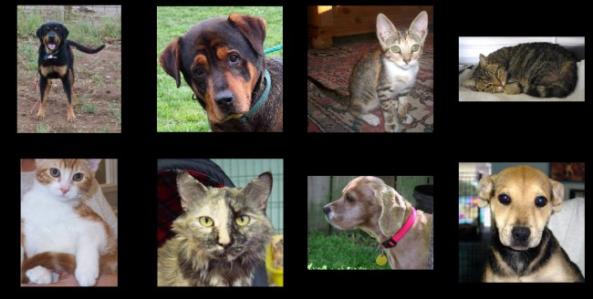
Dataset
It contains pictures of cats and dogs. The reason to pick this dataset was that it was very not very convenient to upload 600 MB of dataset repeatedly in google collab.
we wanted the model to understand the images and use its knowledge to fill the noise. (e.g. If an eye of the cat is 'noised' than the model should know how an 'eye' looks like to fill in the noise) Since this part in the real world would require lots more data and computational power, the above dataset was adequate to train a prototype.
1

Slide 8
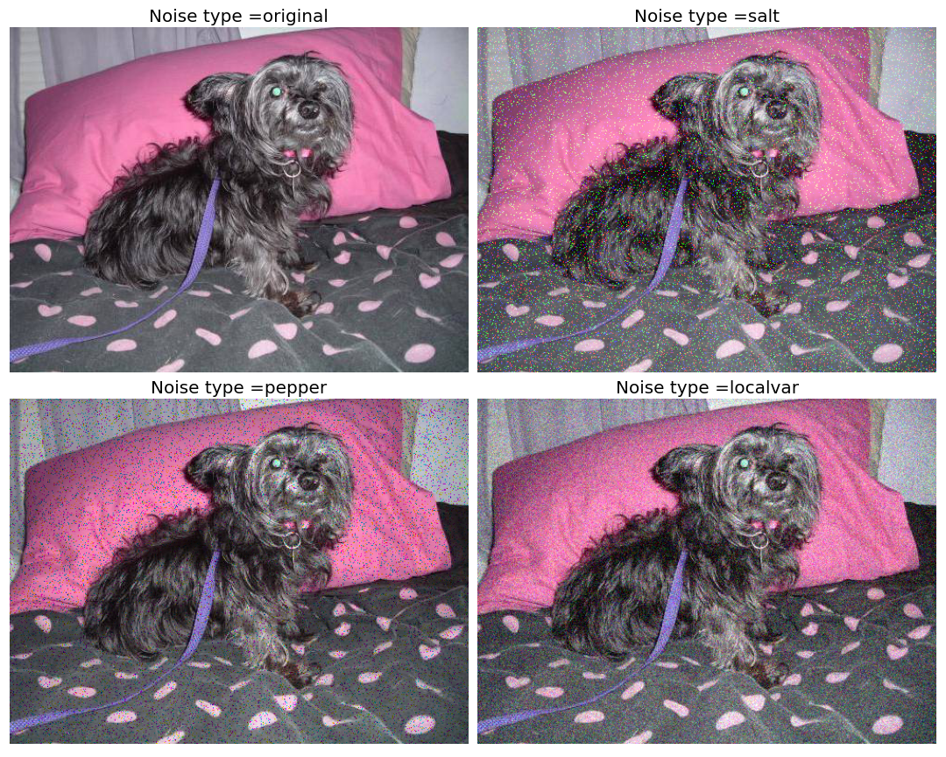
Noise
In this project, we have considered three noises. The Neural Network will single handedly take all this noise into consideration are: pepper, salt, localvar.
Salt / pepper noise is a form of noise sometimes seen on images. It is also known as impulse noise. This noise can be caused by sharp and sudden disturbances in the image signal.
While localvar is zero-mean Gaussian white noise with an intensity-dependent variance.
Before the image is fed to model for training. It would be assigned layers of any of the above three noises randomly with equal probability.
1

Slide 9
Data Augmentation
Data augmentation is used when we don’t have enough training data. Also, it has the effect of regularization.
The usual way of doing the data augmentation is by flipping, cropping, flipping, zooming, shearing etc.
But here we have taken a different approach.Every time the noise produced by the noise function differ, even if the noise-type and the image are the same.
This helps us to feed the model with unique images every time. Apart from this, as discussed above each image fed to the model would be randomly assigned a noise type in every epoch. Thus creating even more augmentation.

Slide 10
Self Supervision
Given a task and enough labels, supervised learning can solve it well. Good performance usually requires a decent amount of labels, but collecting manual labels is expensive and hard to be scaled up. So to get examples of images which are first corrupted and another image which is clean manually is expensive.
Therefore we are using self-supervised learning, where using a subset of the information we are trying to predict the whole information. In our project, the subset being the corrupted image in which some information has been destroyed by corruption and the Deep Learning model are tasked to find the original image which has full information.
We have used total 5 noises for each of the model.

Slide 11
Evaluation Methodology
PSNR - Peak signal-to-noise ratio, PSNR is most commonly used to measure the quality of reconstruction of lossy compression codecs (e.g., for image compression). When comparing compression codecs, PSNR is an approximation to the human perception of reconstruction quality.
SSIM - structural similarity index measure is a method for predicting the perceived quality of digital television and cinematic pictures, as well as other kinds of digital images and videos. Structural information is the idea that the pixels have strong inter-dependencies especially when they are spatially close. These dependencies carry important information about the structure of the objects in the visual scene.
Visual Inspection - We might have a good SSIM or PSNR score, still it does not convey full information. For example, while training we came across moments where one loss function would have a better result compared to another loss function but it did not have the same visual appearance as it would be in greyscale. But the other one was at least colourful.

Slide 12
Assumptions
State your assumptions or any unknowns here.

Slide 13
Solution description
Now that you’ve justified your attention to the problem, summarize your solution in one or two sentences.

Slide 14
Why it’s better than existing solutions
Return to the problem now that you’ve introduced your solution. Compare your solution to others and describe how it is superior.

Slide 15
Results

Slide 16
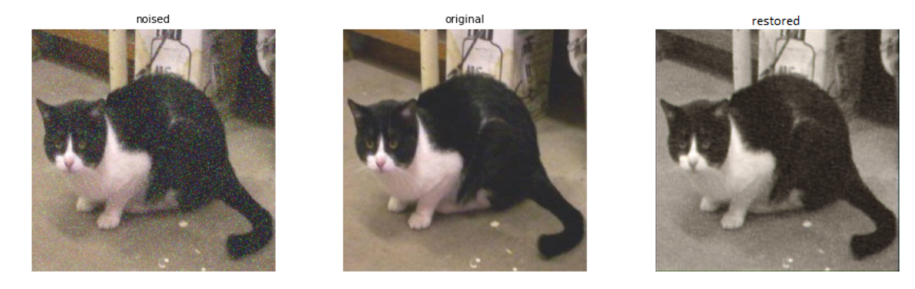
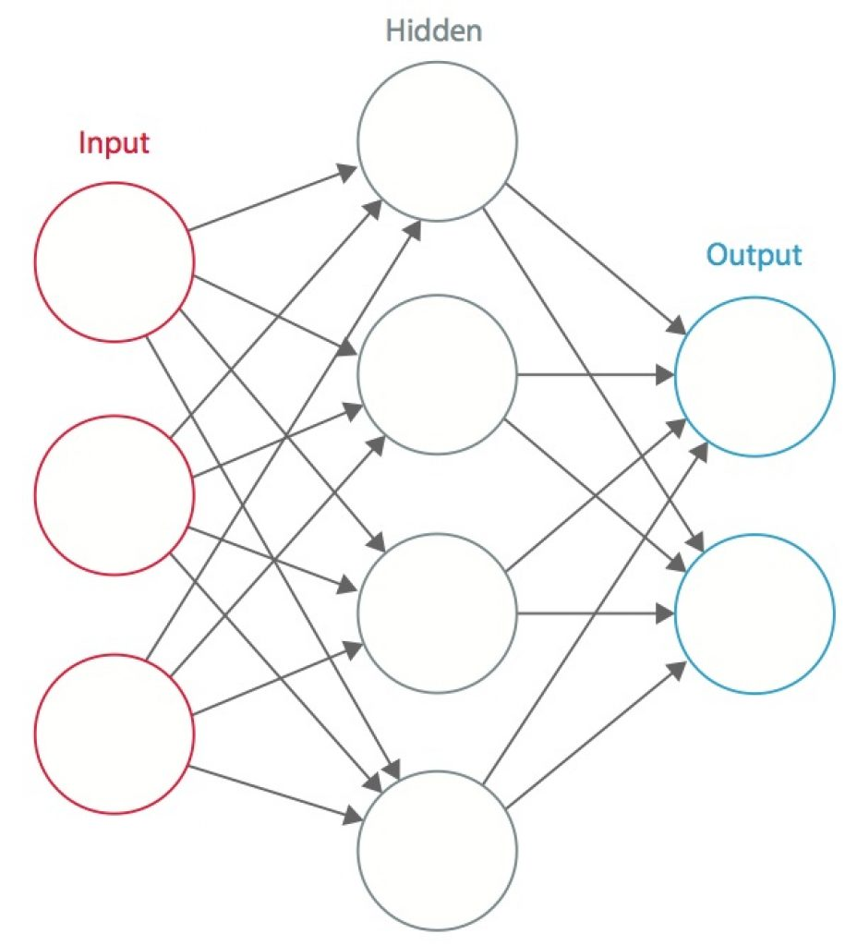
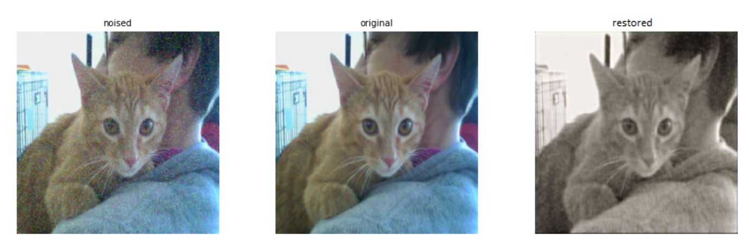
Model 1
Model 2
CNN Models: (Model 1 and 2)
At the start, we used 2 simple CNN models.
A Convolutional Neural Network (CNN, or ConvNet) is a class of deep neural networks, most commonly applied to analyzing visual imagery.
The results weren’t great and it did not remove much noise from the images.

Slide 17
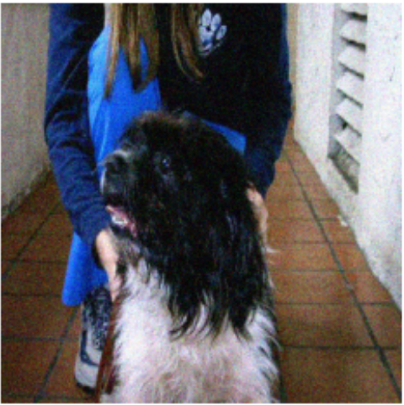
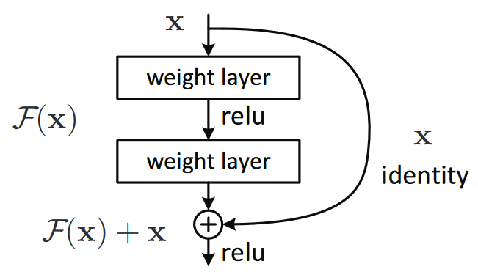
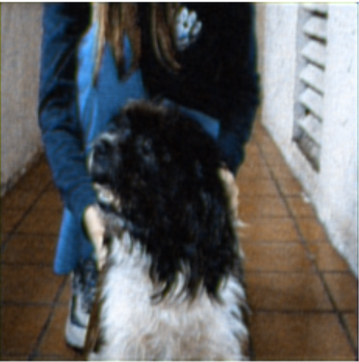
Model 3
With noise
Restored
Skip connections: (Model 3)
The next model involved a skip connection for faster gradient descent.
Skip connections are extra connections between nodes in different layers of a neural network that skip one or more layers of nonlinear processing.
After looking at the working of models on the intended scale, we can conclude that our objective is being accomplished to some degree

Slide 18
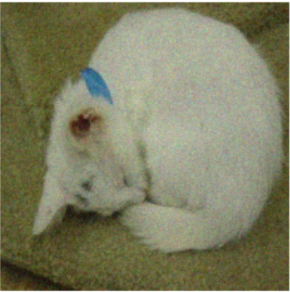
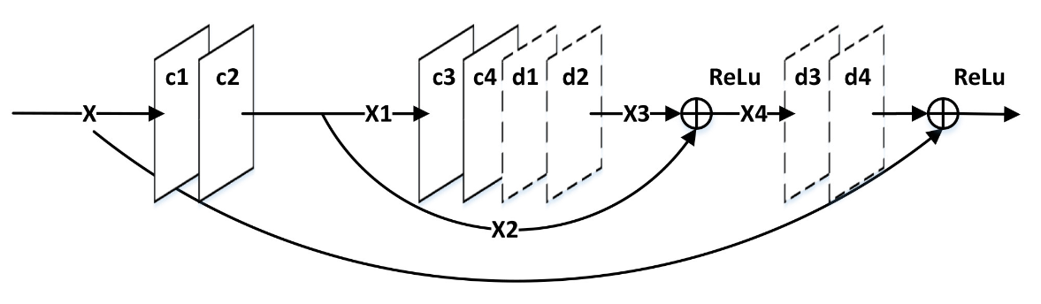
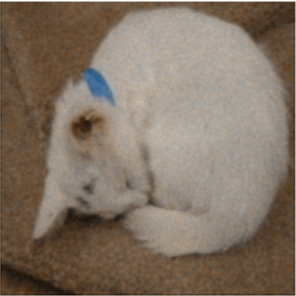
Model 4
With noise
Restored
Symmetric Skip Auto Encoder: (Model 4)
The next model involved an auto-encoder with a symmetric skip connection for faster gradient descent.
Symmetric Skip Auto Encoder consists of a chain of symmetric convolutional layers and deconvolutional layers. The convolutional layers act as the feature extractor which encode the primary components of image contents while eliminating the corruptions.
Our model can definitely recognize the subject of the image and reduce noise to a great degree, however the issue of desaturation is not fully dealt with.

Slide 19
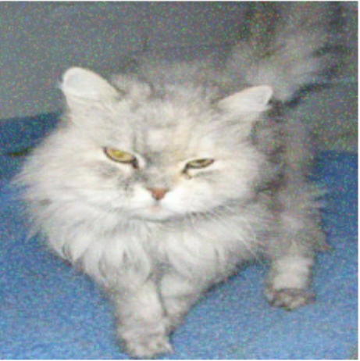
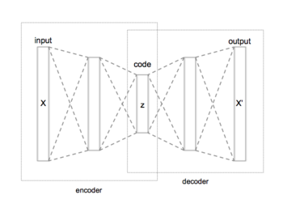
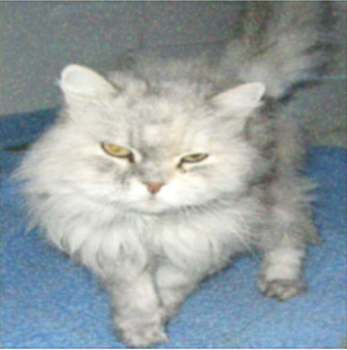
Model 5
With noise
Restored
Inverted Auto Encoder: (Model 5)
The previous model was an auto-encoder which took an image, compressed it using an encoder and then again expanded on it by a decoder. So, we decided to use an inverted form of autoencoder, i.e., We first expand the image with the help of encoder and then compress it to its right size.
Looking at the results from the enhanced models we can see that the issues of desaturation and loss of clarity have been almost completely eradicated, leaving us with an almost fully accurate image restoration.

Slide 20
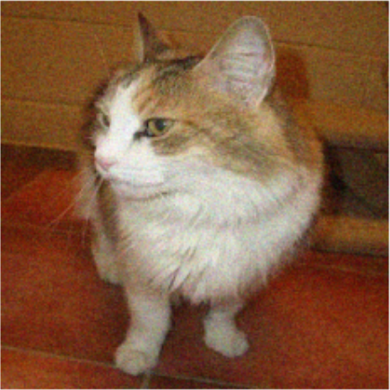
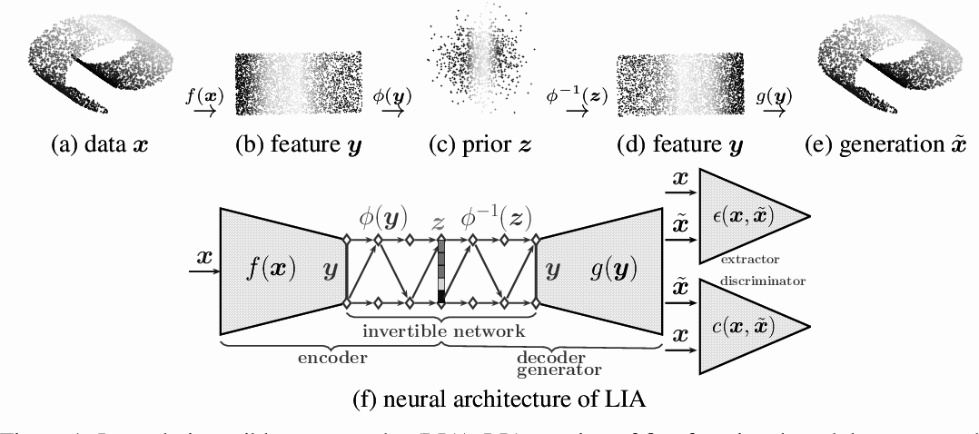
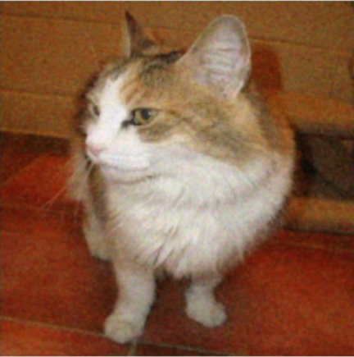
Model 6
With noise
Restored
Inverted Auto Encoder: (Model 6)
Since the previous model worked really well, we tried to optimize it further. Here, we used another inverted auto-encoder and tried optimizing by changing it’s layers.
An interesting observation here was that noise on subjects was removed much better than the background noise.
It shows that the neural network learned how a cat of dogs looks and uses its knowledge to fill the noise on them much faster.

Slide 21
Observations from the Model
The focus of the model
Computational complexity cannot be reduced completely.
Having raised scale and used losses to enhance our model has made it more adaptive and capable of growth.
It is capable of recognizing the subject of the image and differentiate it from the background. (Eg: The cats and dogs)

Slide 22
Next Steps

Slide 23
Future plans?
Having built and enhanced our models, the next obvious step would be to work on availability of this image restoration service.
Integration with mobile application/computer application/website.
This integration will make it available to any interested individual, even if they have no knowledge of python systems.
Producing a user friendly and fast interface for the application/website that can accept input images and return the restored image.
In the next part of project the project I had we are going to use the current result for making an expanding neural network. So we are going to use the loss function and model based on the reesult of this project.

Slide 24
Thank you

